Slide 1
COMMON RAIL DIRECT INJECTION SYSTEM(CRDI)

Slide 2
Basic diesel fuel systems
Diesel engine during suction stroke only air is come through intake valve into the cylinder
The air is compressed
Fuel is injected into the cylinder at high pressure
The amount of fuel injected suits to the load and controls engine speed

Slide 3
FUNCTIONAL REQUIREMENTS OF AN INJECTION SYSTEM
Accurate metering of the fuel injected per cycle. The quantity of the fuel metered should vary to meet changing speed and load requirements of the engine.
Correct timing of the injection of the fuel in the cycle so that maximum power is obtained.
Proper atomization of fuel into very fine droplets.
Uniform distribution of fuel droplets throughout the combustion chamber

Slide 4
TYPES OF INJECTION SYSTEMS
Air Injection System:
In this system, fuel is forced into the cylinder by means of compressed air. This system is little used nowadays
Solid Injection System:
In this system the liquid fuel is injected directly into the combustion chamber without the aid of compressed air.
It can be classified into four types.
Individual pump and nozzle system
Unit injector system
Common rail system
Distributor system

Slide 5
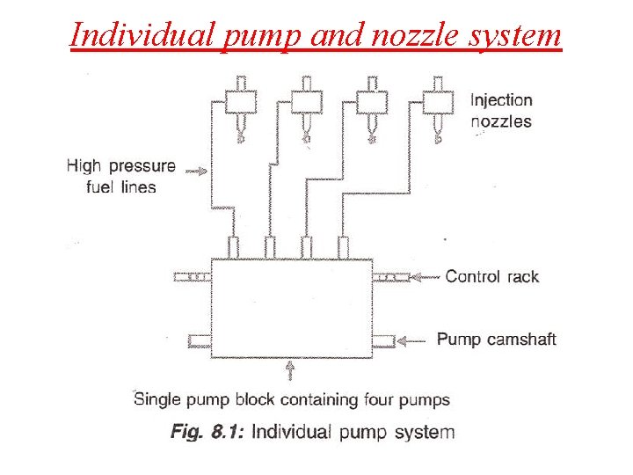
Individual Pump and Nozzle System:
In this system, each cylinder is provided with one pump and one injector.
A separate metering and compression pump is provided for each cylinder. The pump may be placed close to the cylinder
The amount of fuel injected depends on the effective stroke of the plunger.

Slide 6
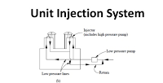
Unit Injector System:
In this system a pump and the injector nozzle are combined in one housing.
Each cylinder is provided with one of these unit injectors.
Fuel is brought up to the injector by a low pressure pump
The amount of fuel injected is regulated by the effective stroke of the plunger

Slide 7
Common rail system
In CRDI (Common Rail Direct Injection), there is a common line which is called Common-Rail, and each injector is connected to this line.
Through this line, fuel sent into the cylinders.
In conventional diesel engines the pressure needs to be readjusted for each injection process, while in CRDI the pressure is always constant and this pressure remains constant along the fuel line.
The ECU adjusts the injection timing of the injectors depending on the engine load and speed.
The amount of fuel to be delivered to the combustion chamber is set by the ECU with the information which is provided by the sensors in the engine.

Slide 8
Unburned fuel is significantly reduced after combustion stage
Fuel is supplied to the combustion chamber when it is needed, fuel is not sent to the combustion chamber when it is not needed.

Slide 9
Components of CRDI Engine

Slide 10
High Pressure Fuel Pump
The high-pressure fuel pump is located between the low pressure and high-pressure pipes. The basic function is to transmit the fuel to the system at the required pressure.
The high-pressure fuel pump is supplied by electric.
Fuel Metering Control Valve
It is located back side of the HPP.
Controls amount of fuel.
Controlled by ECU.
High Pressure Regulator Valve
Controls high pressure fuel which is delivered to common rail.
Sends excess fuel into the fuel tank
Cool downs the fuel before sends it to the tank

Slide 11
High Pressure Accumulator (Common-Rail)
The fuel is sent to the common rail at high pressure.
The fuel is stored here and distributed by injection.
In addition, common-rail eliminates vibration caused by the high-pressure pump.
Generally, the fuel rail works between 300-400 bar at idle position and it can reach 1600-2200 bar at maximum working conditions.

Slide 12
Fuel Pressure Sensor
Fuel pressure sensor is located on the fuel rail. It measures the fuel pressure on the Common Rail and communicates with the engine computer.
Rail Pressure Limiter Valve
It is located on the fuel rail. If there is generated excessive amount of pressure, that pressure relieved by the rail pressure limiter valve and excessive fuel sent back to fuel tank.

